Slide 1
Introduction to the ER Model
and its related terms
Course
Database Management System
Name
Rajani Bhusal(BCSIT 3rd)
Date
2081-10-07

Slide 2
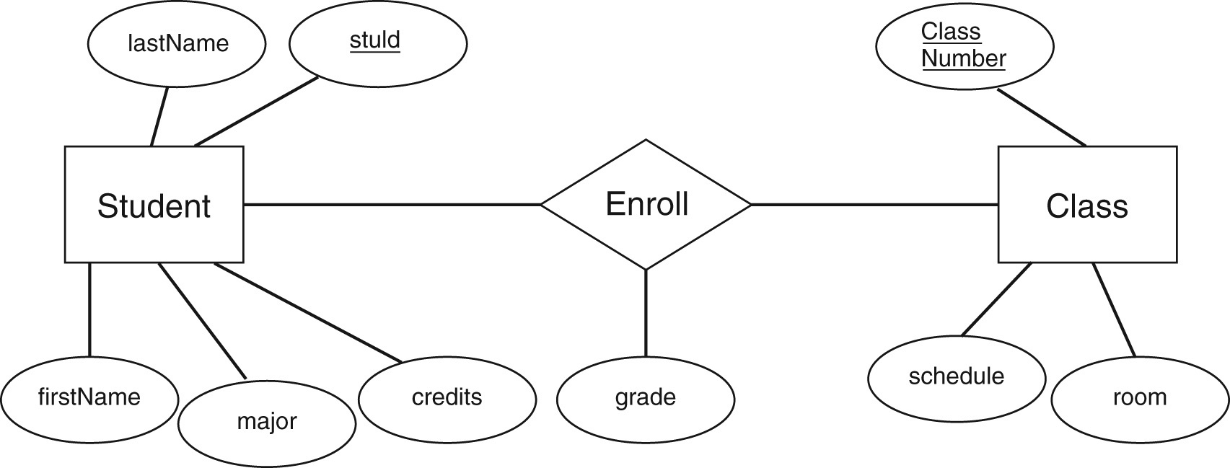
Introduction to the ER Model
The Entity-Relationship (ER) Model is a high-level data model used to define the data elements and relationships for a specified system. It displays the relationship of entity sets. It is created based on three basic concepts: entities, attributes and relationships.

Slide 3
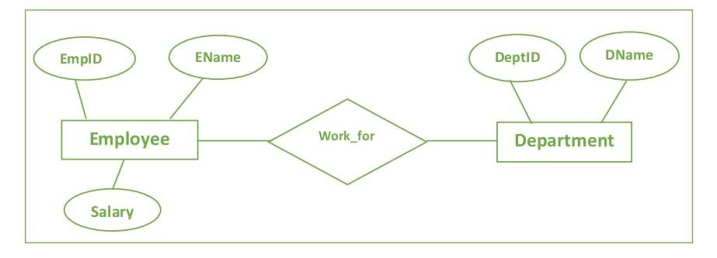
Purpose of ER Model
Data Organization: Helps in structuring and organizing data elements and their relationships.
Database Design: Serves as a blueprint for creating databases.
Communication Tool: Provides a clear visual representation for stakeholders.
Documentation: Captures data requirements and structure for future reference.

Slide 4
When to use ER Model
The ER Model is used in the initial stages of database design to visually represent data elements and their relationships. It helps organize data, facilitates communication among stakeholders, and serves as documentation for future reference. This model ensures that all necessary data elements and their relationships are accurately captured, making it easier to design and maintain databases effectively.

Slide 5
Entity Types
An entity type is a category of objects that share common characteristics and are represented in a database. In an ER Model, an entity type is a collection of entities with the same attributes, like "Student" or "Course" in a university database. These entities are used to model real-world objects and their relationships within the database, making it easier to organize and manage data.
An entity can be of two types :-
Tangible Entity: Entities that exist in the real world physically. Example: Person, car, etc.
Intangible Entity: Entities that exist only logically and have no physical existence. Example: Bank Account, etc.

Slide 6
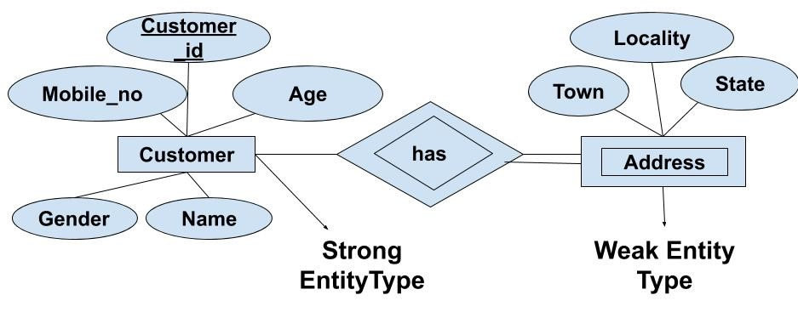
Examples of Entity Types
An entity type is a category of objects that share common characteristics and are represented in a database. In an ER Model, an entity type is a collection of entities with the same attributes, like "Student" or "Course" in a university database. These entities are used to model real-world objects and their relationships within the database, making it easier to organize and manage data.

Slide 7
Steps of making ER Model
Identify Entities and Attributes: Determine the main objects (entities) and their characteristics (attributes). For example, "Employee" with attributes EmpID, EName, and Salary; "Department" with attributes Dept-ID and D-Name.

Slide 8
2.Determine Relationships: Identify how the entities are related. For example,
"Employee" works for "Department."
3.Draw Entities and Relationships: Represent each entity as a rectangle and each
relationship as a diamond. Connect entities to relationships with lines.
fig. Entities
fig. Relationship
fig. Attributes

Slide 9
4.Add Attributes: Represent each attribute as an oval and connect them to their
respective entities with lines.
Fig. ER Model of an Office

Slide 10


Conclusion
In conclusion, the ER Model is a valuable tool for designing and organizing databases. It helps visualize data elements and their relationships, facilitating clear communication and accurate data representation. This model ensures efficient database design and serves as essential documentation for future reference.

